Slide 1
Planetary Gear System
By Bryce DeAlessio

Slide 2
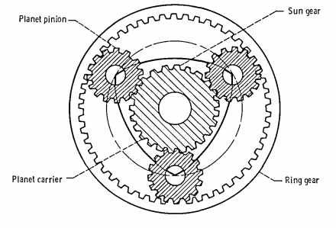
Definition
A planetary gear is an assembly of gears arrayed around each other in a concentric pattern.
High gear ratio and speed reduction in a compact configuration. The configuration allows the input and output shafts to lie on the same axis.
Figure1
Notes:
Figure 1 obtained from following source and used for Figures 1-1 Thru 1-4 and subsequent figure modifications [2] Coy, John J., Dennis P. Townsend, and Erwin V. Zaretsky. https://ntrs.nasa.gov/archive/nasa/casi.ntrs.nasa.gov/19860005142.pdf . Cleveland, Ohio: Nasa Lewis Research Center, Dec. 1985. Pdf. NASA Reference Publication 1152

Slide 3
Functional Overview
The configuration of a planetary gear box consists of:
A central gear often called the sun gear.
A set of planet pinion gears which orbit around the same axis of the sun gear.
A carrier frame which the planet gears mount to.
A ring gear with internal teeth that mesh with all the planet gears simultaneously.
any one of the three gear sets (the sun gear, carrier plus planet gears or ring gear) can be fixed.
1
2
3
4

Slide 4
Sun Gear
The gear about which the rest of the gear assembly rotates.
Made of a material that can withstand high speeds and heat.
Typically the driving member of the assembly. It’s teeth mesh with the planet gears.
1
Figure 1-1

Slide 5
Planet Pinion Gears
The planet gears orbit the sun gear and must have the same type of teeth as the sun gear.
The number of teeth of each planet gear match.
More planet gears increase load capacity.[1]
2
Figure 1-2
Notes:
[1] The World of Planetary Gears Mar 1, 2000 Charles S. Kaim Associate Editor | Motion System Design - http://machinedesign.com/motion-control/world-planetary-gears

Slide 6
Carrier
The Carrier is a single piece frame in which the planet gears are mounted to.
The carrier holds the planet gears at a specific diameter and equal pitch.
It Rotates on same axis as the sun gear.
3
Figure 1-3

Slide 7
Ring Gear
The ring gear is the largest gear in the assembly
It encompasses the entire assembly.
It has Internal teeth that mesh with the external teeth of the planet gears.
4
Figure 1-4

Slide 8
Conclusion
Planetary Gear systems have a wide variety of use cases. Any where a large reduction in speed and increase in torque is required in a small space you will find them.
Some specific use cases would be
The PT6A turbo-prop engine (made famous by fictional Disney character Dusty Crophopper “My Gear box is busted”)
Any type of Power Drill
The new Generation of Pratt & Whitney Geared Turbo-Fan Engines.

